Slide 1
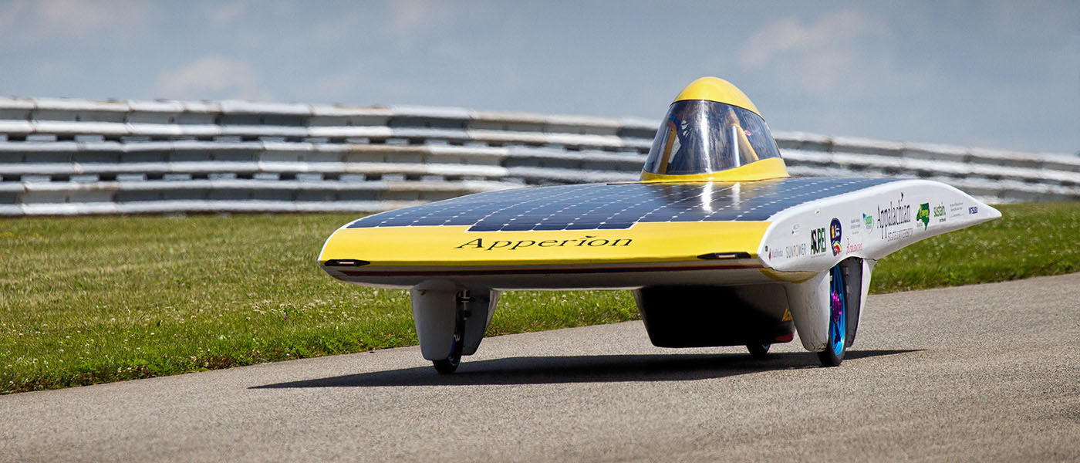
Light Solar Vehicles
Dr. John Martin
Appalachian State University
2019

Slide 2
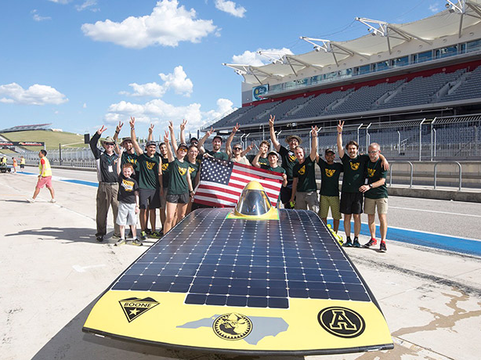

Slide 3
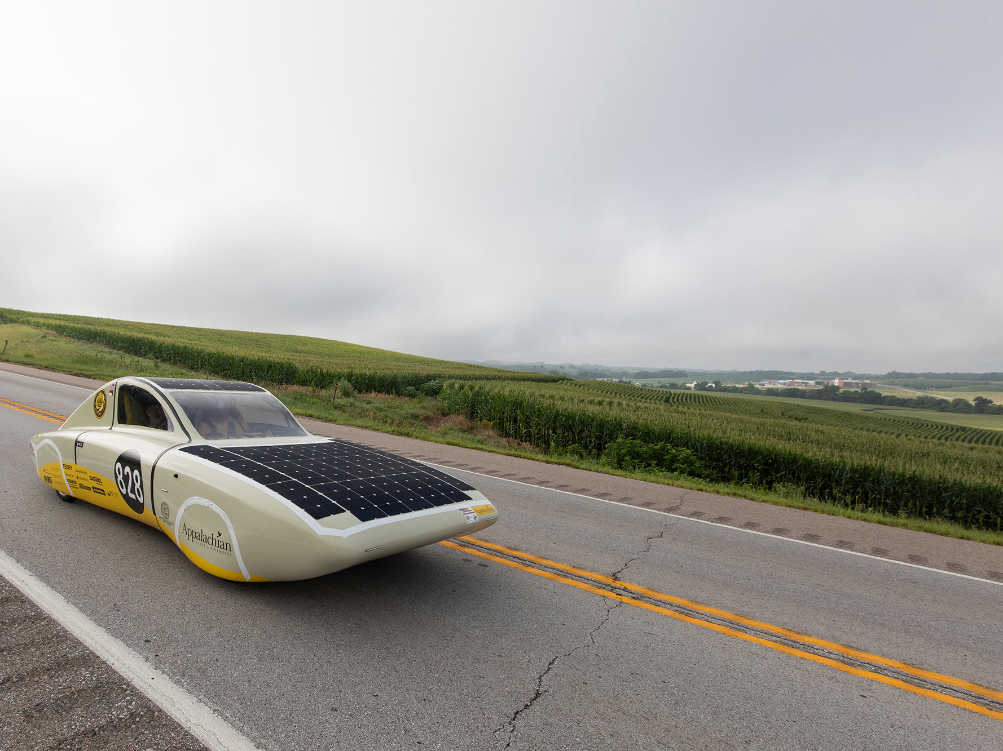
ROSE (Racing on Solar Energy)
Appalachian State – Team Sunergy

Slide 4
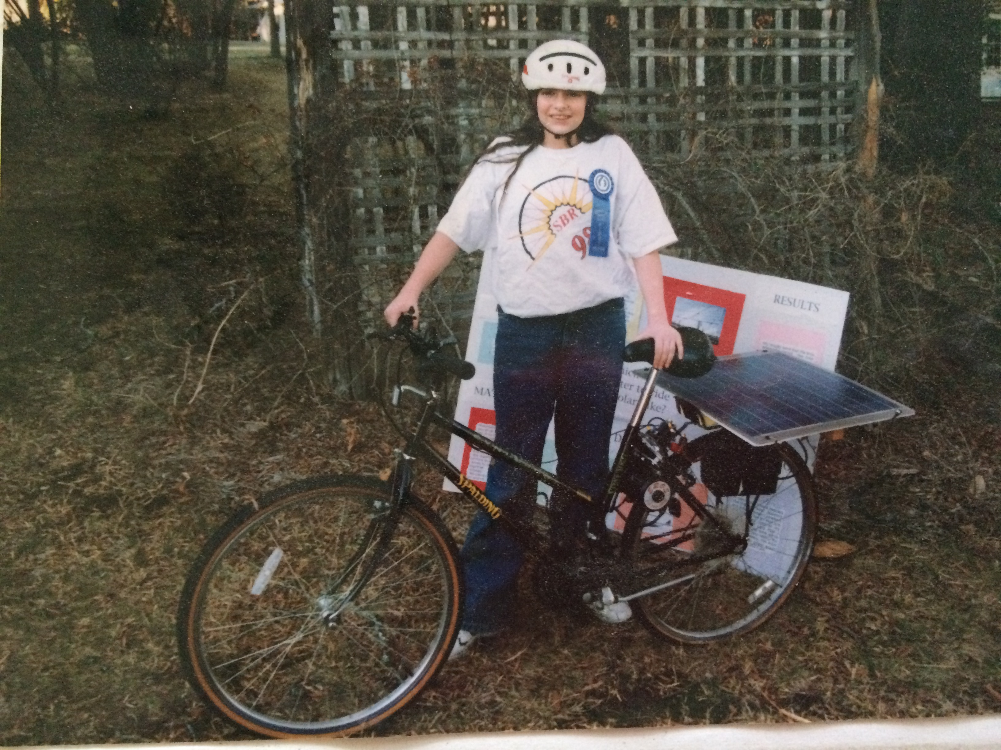

Slide 5
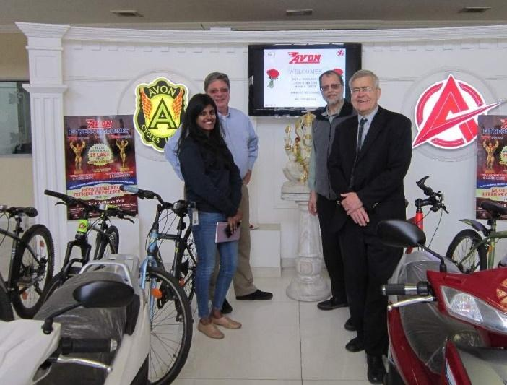

Slide 6
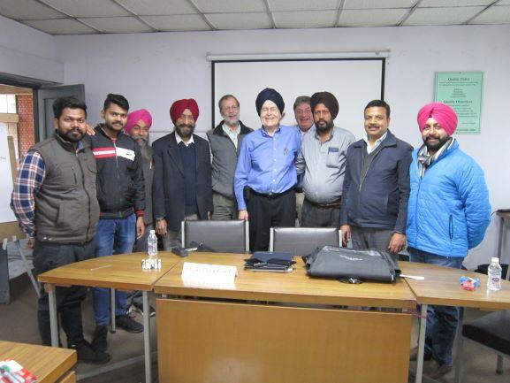

Slide 7
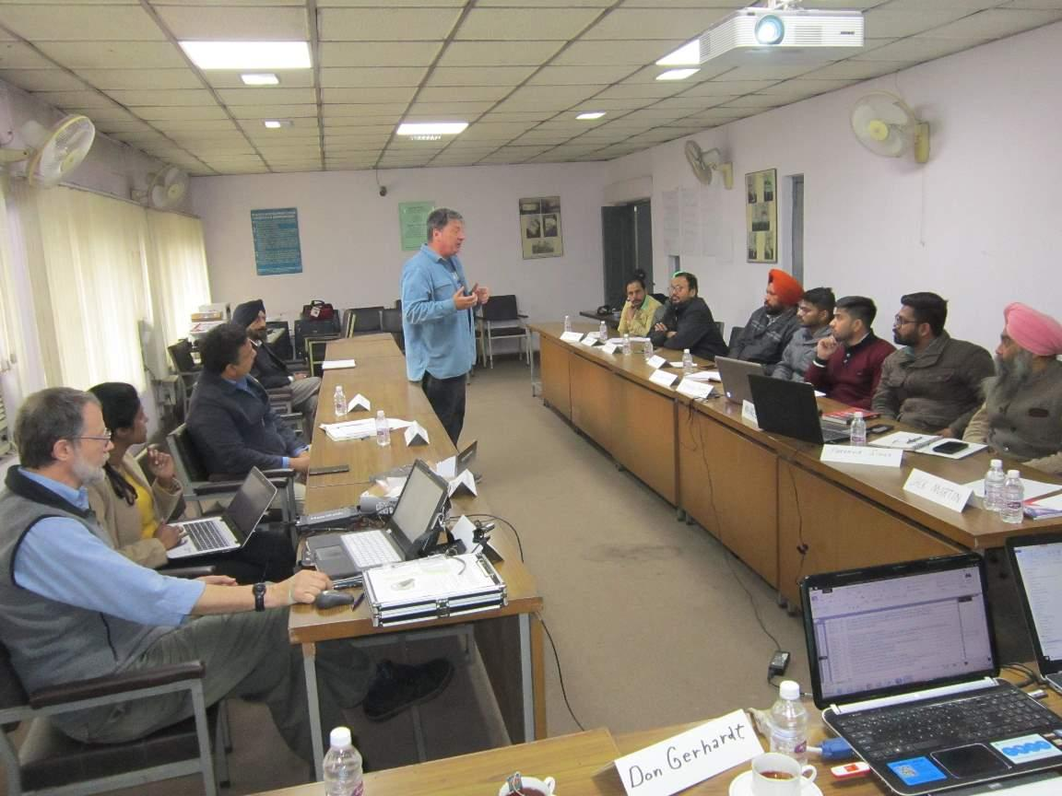

Slide 8
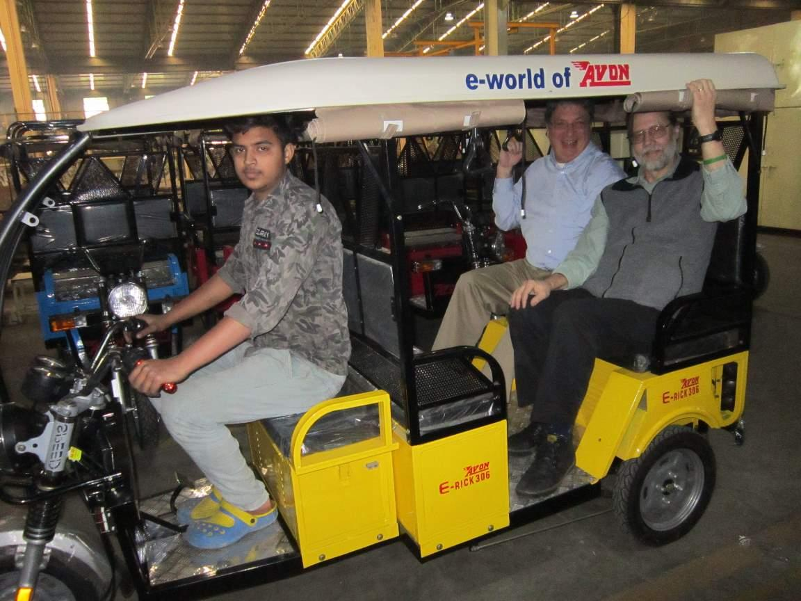

Slide 9
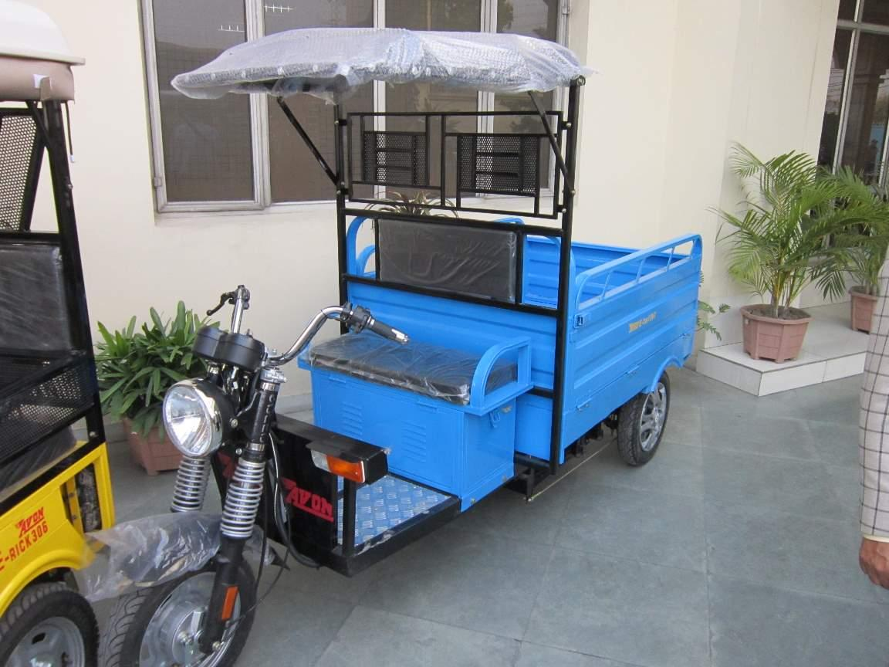

Slide 10
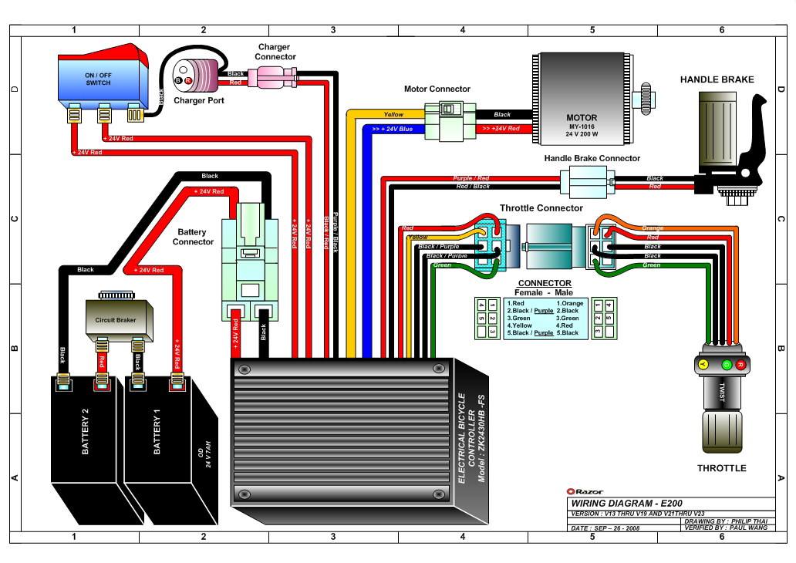

Slide 11
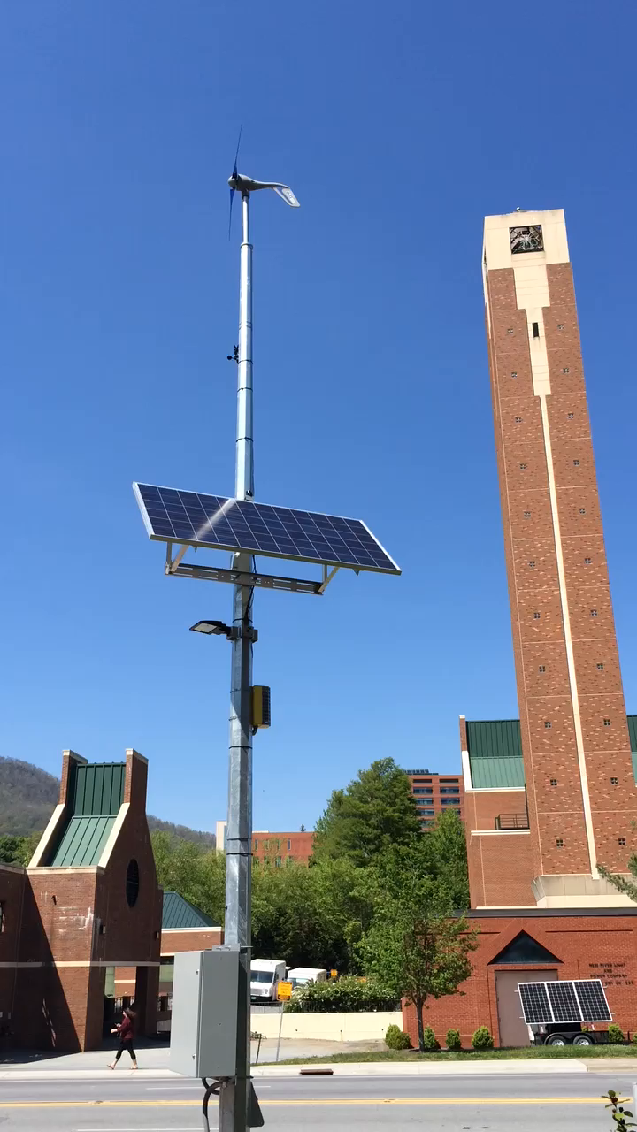
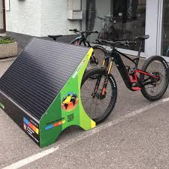

Slide 12
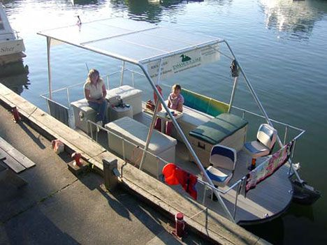

Slide 13
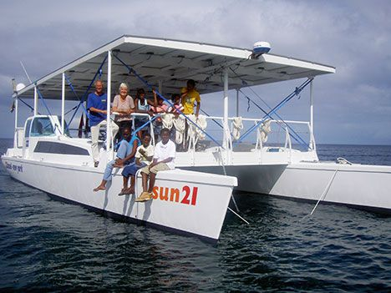

Slide 14
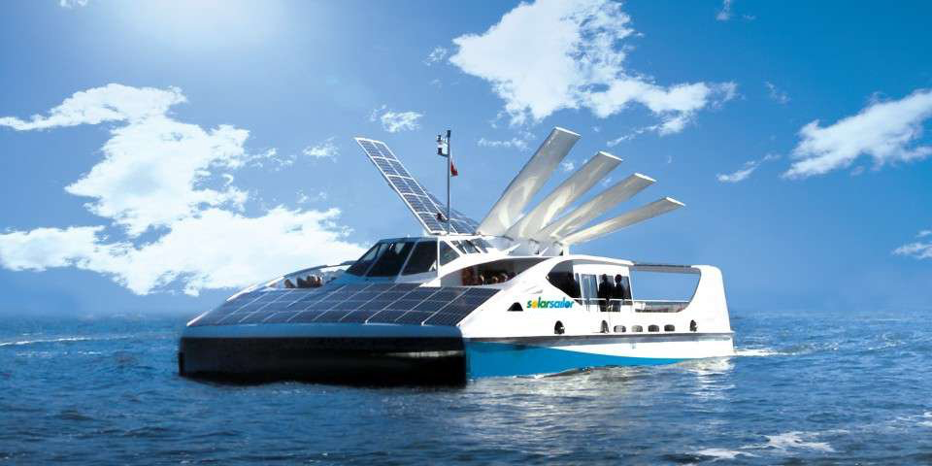

Slide 15
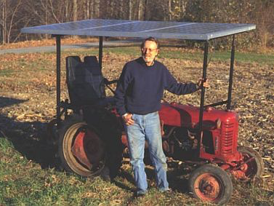

Slide 16
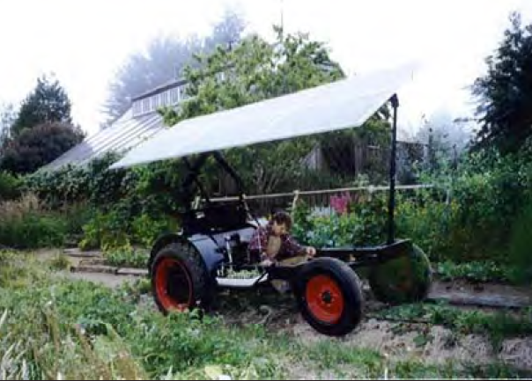

Slide 17
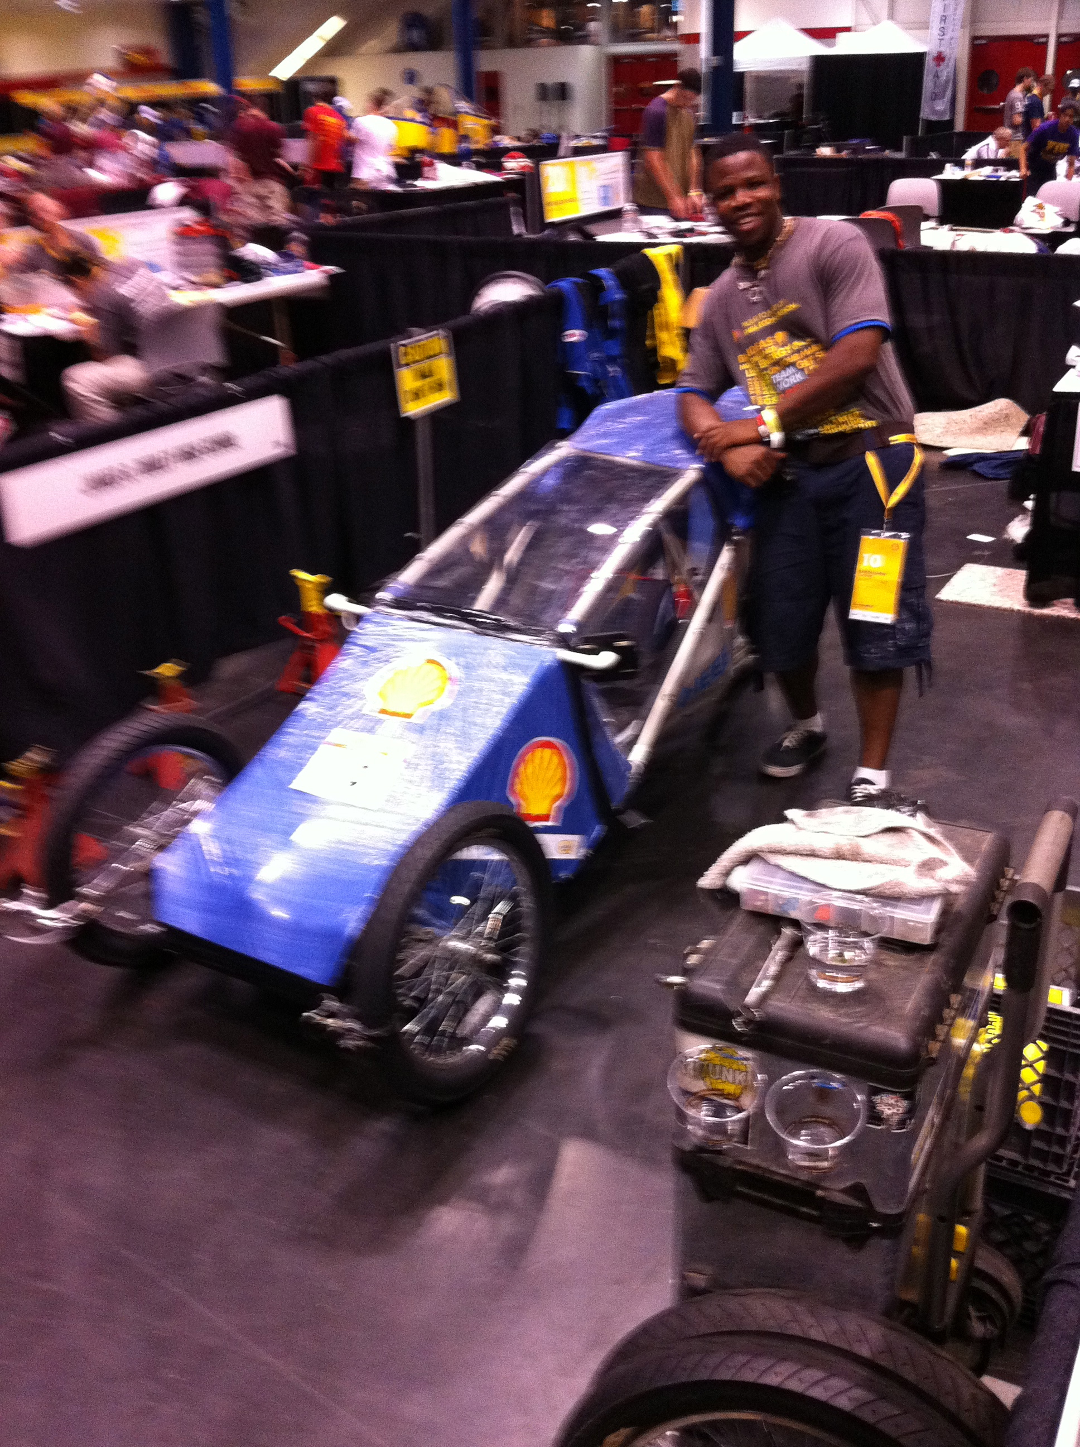

Slide 18
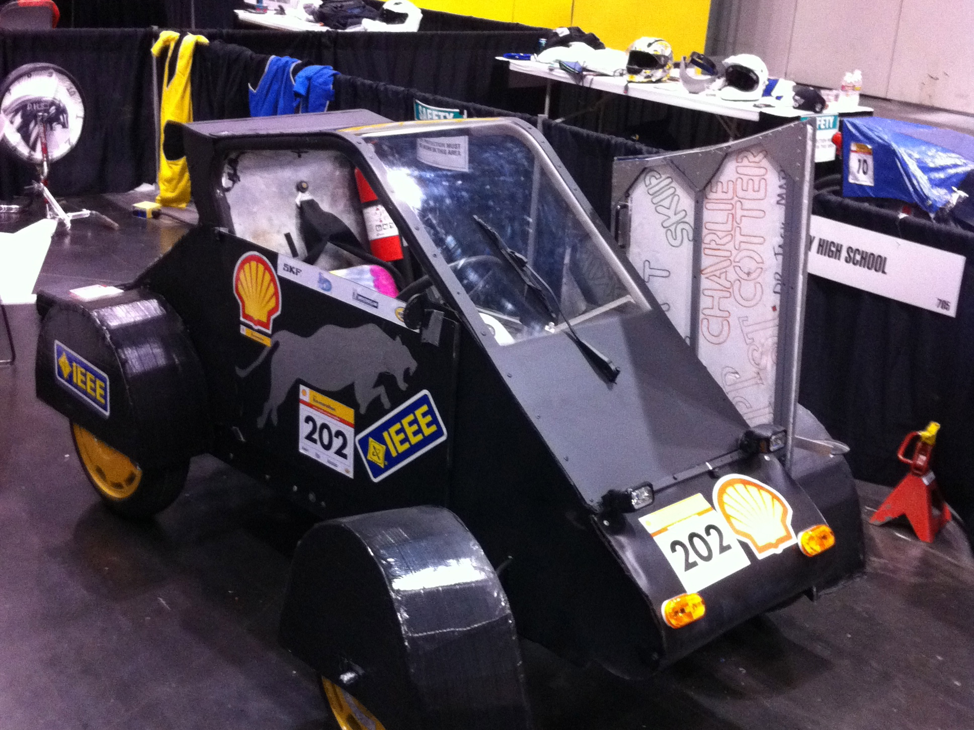

Slide 19
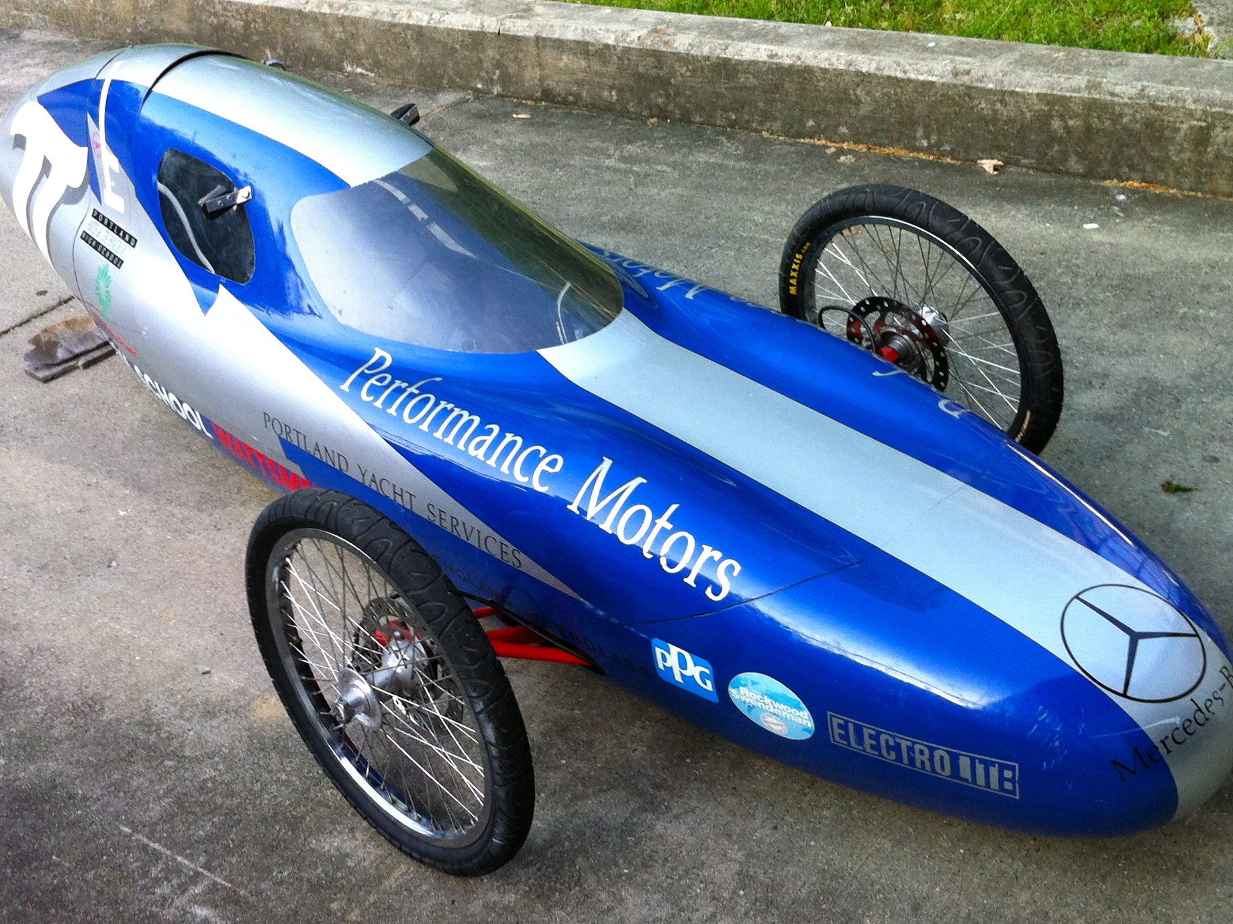

Slide 20
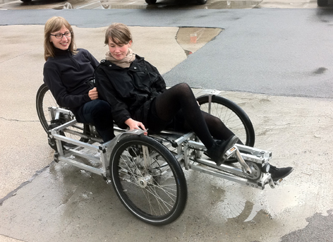
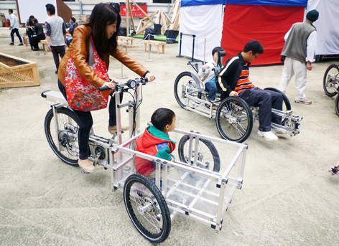
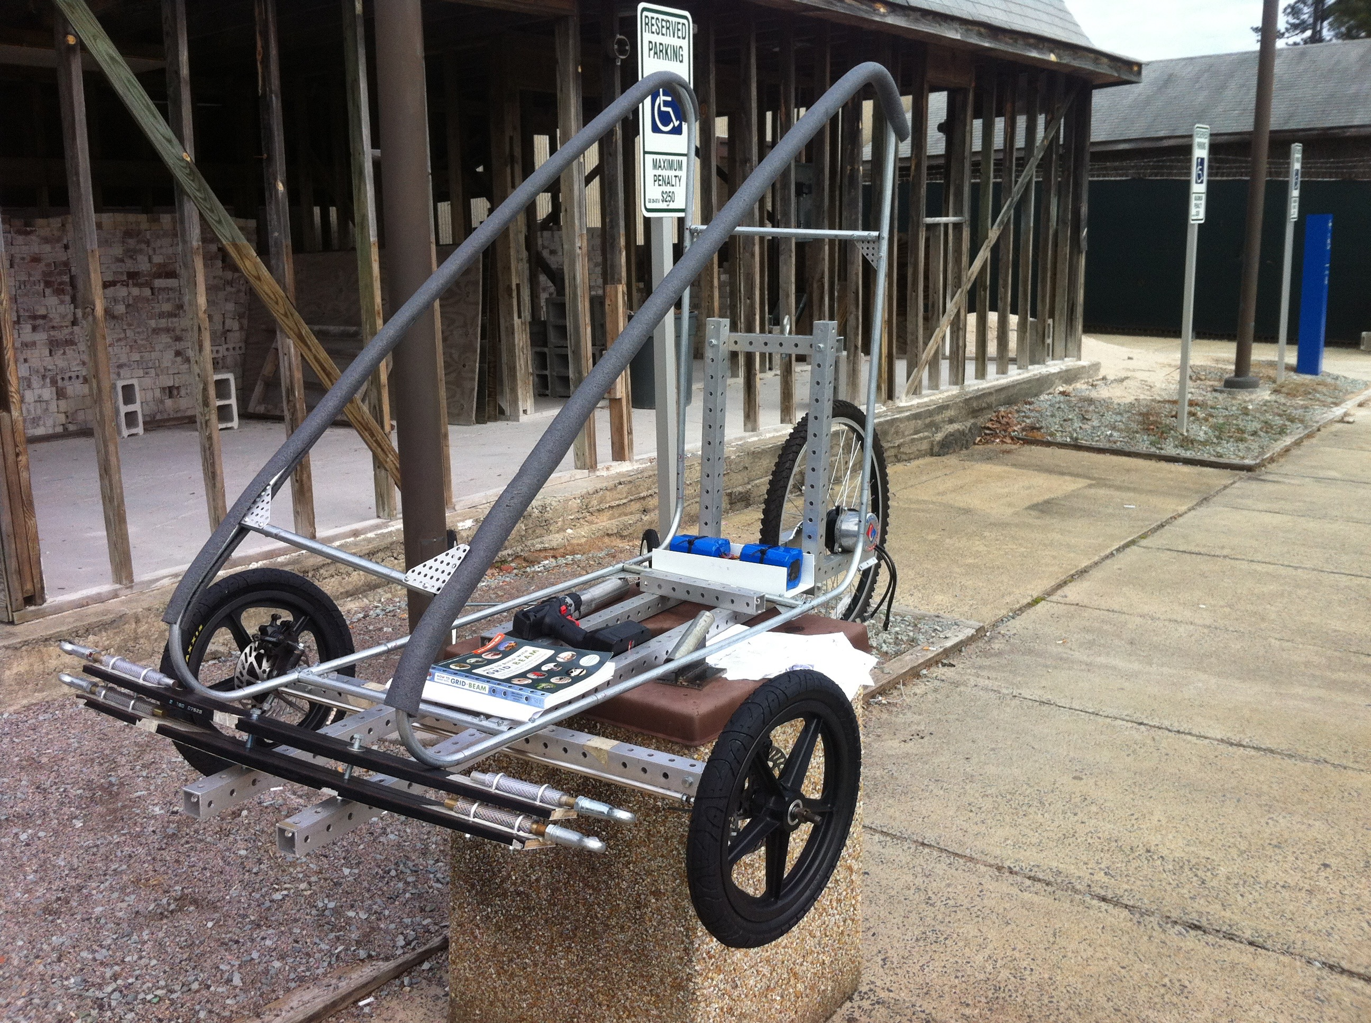

Slide 21
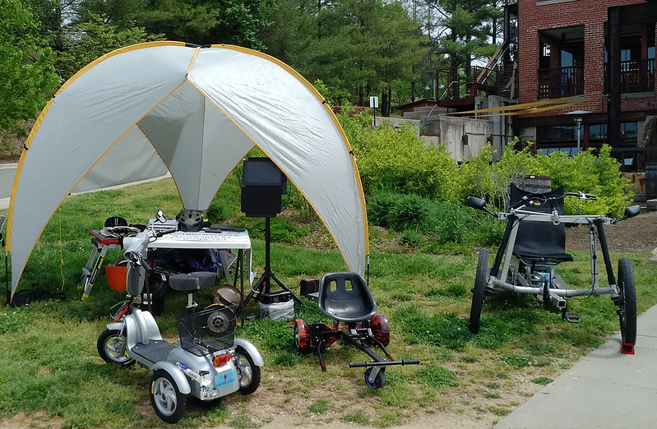

Slide 22
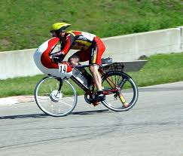


Slide 23
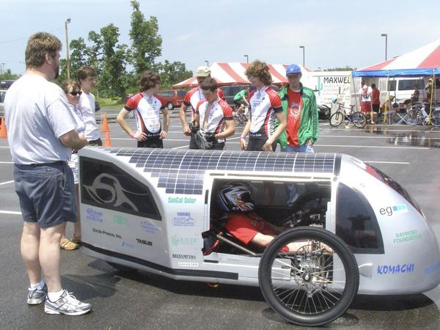

Slide 24
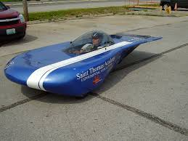

Slide 25
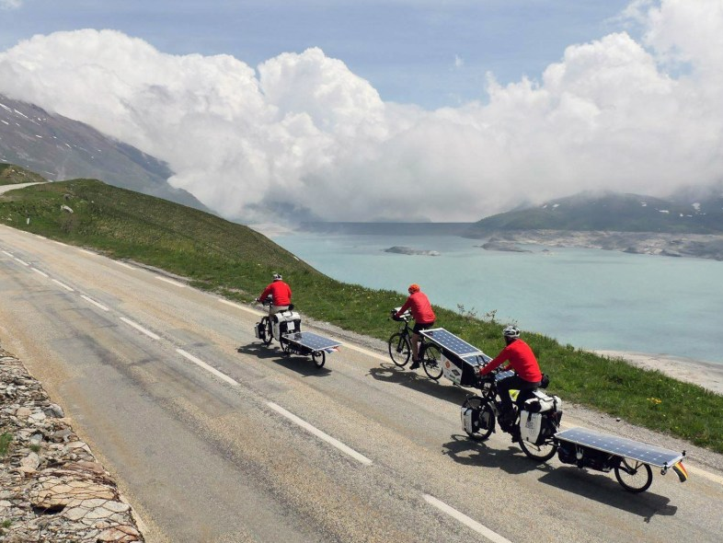

Slide 26
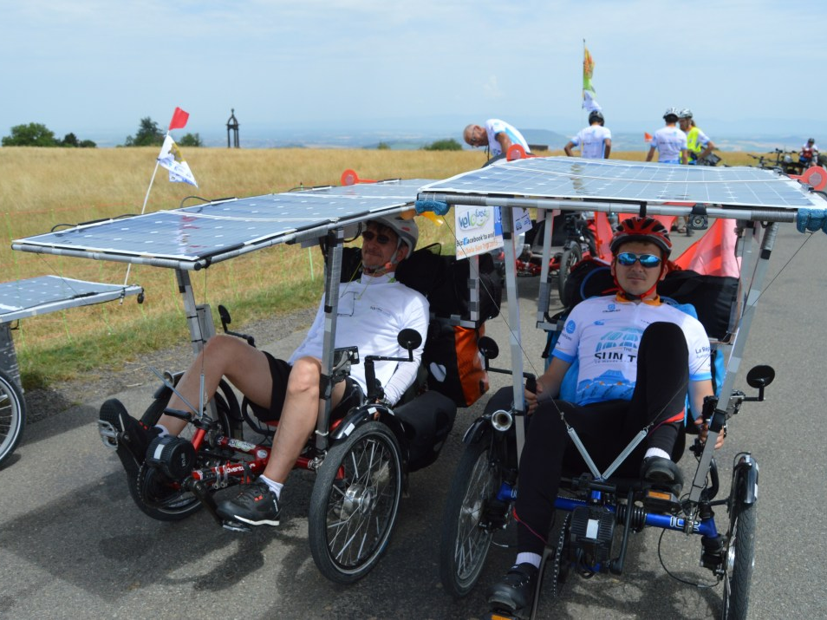

Slide 27
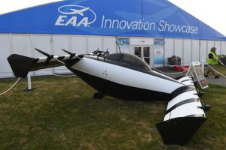

Slide 28
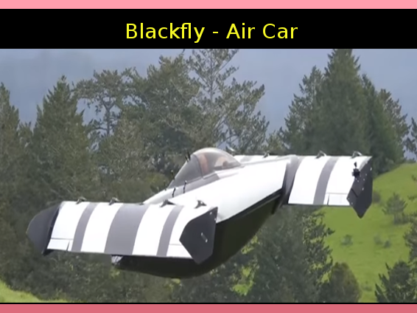

Slide 29
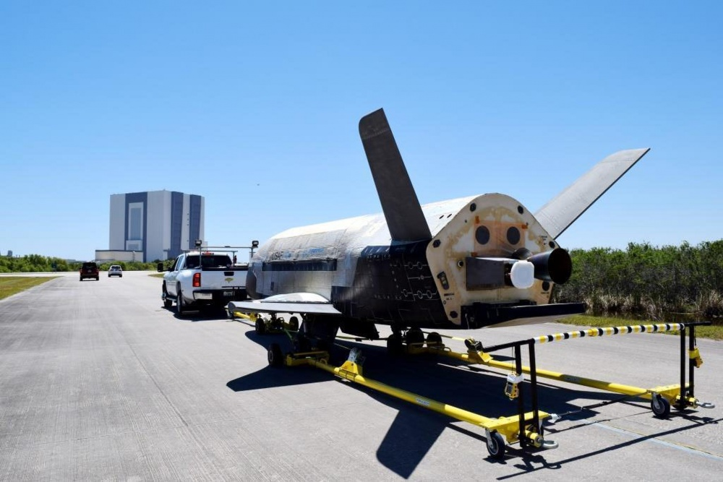

Slide 30
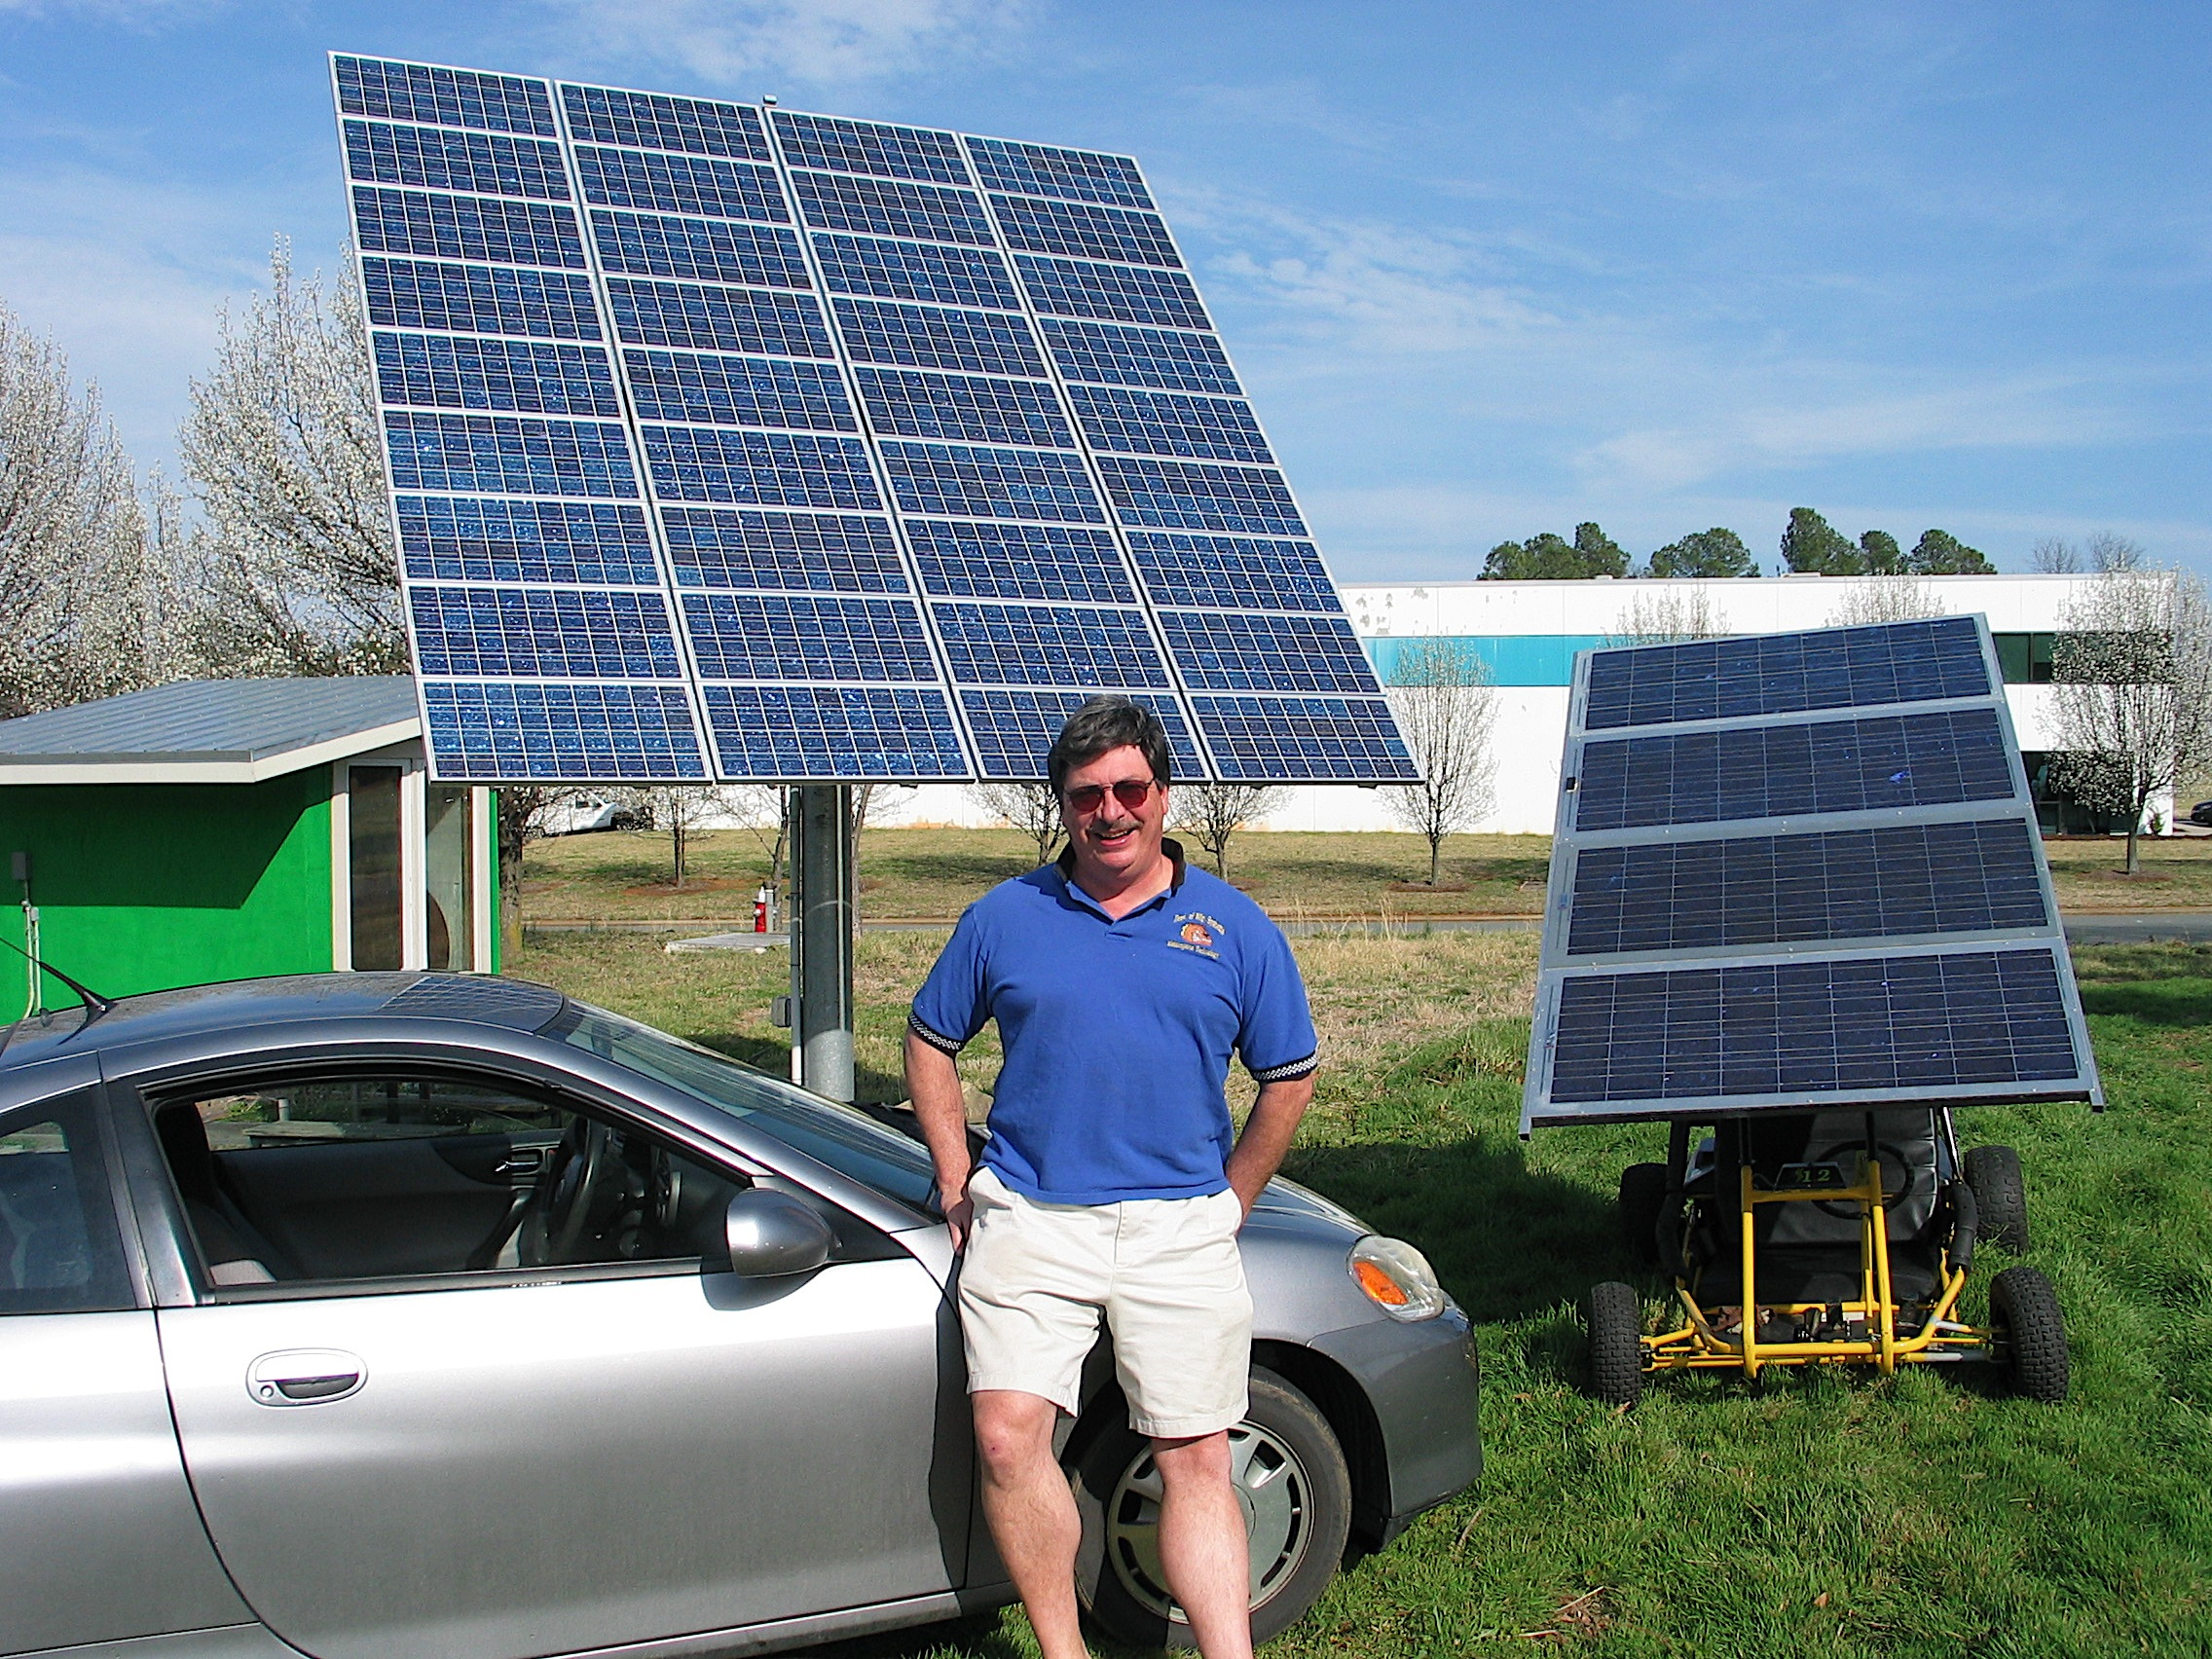

Slide 31
References:
Asu solar car https://today.appstate.edu/_images/_posts/2016/08/racing-the-sun/racing-the-sun-apperion.jpg
https://levassociation.com/tech-training/
www.teva-nc.org
Solar boats- web- https://www.treehugger.com/cars/7-awesome-solar-boats-you-must-see.html
grin technologies web- https://www.ebikes.ca
Solar tractors- web- http://www.tractor9.com/solar-tractors-for-agriculture.pdf
Solarbike rayce-web-http://www.speedace.info/solar_racing_events/solar_bike_rayce_usa.htm
https://www.thesuntrip.com/presentation/presentation-en/
3 video STEMcycle
video- https://www.youtube.com/watch?v=6o9Oj_XUXjQ
video- https://www.youtube.com/watch?v=dypTNc0ooY8&feature=youtu.be 20-2:20
2 FFR Outriderusa web- https://outriderusa.com
video- https://www.youtube.com/watch?v=ePU-aELIdwU
2 Organic Transit Elf web https://organictransit.com
video- https://www.youtube.com/watch?v=lhey6x8CRe8 9:55
Black Fly- web- https://www.opener.aero
Video-https://www.youtube.com/watch?v=jozITRIYLL4

